Slide 1

Connecting Our Community: THE Pub/Sub Solution for ESL Resources

Slide 2

The Challenge: Connecting ESL Students with the Right Resources
Inefficient Communication: Lack of a centralized platform hinders communication between students, providers, and administrators.
Limited Visibility for Providers: Organizations offering ESL courses have difficulty reaching potential students and collaborating with other providers.
Scattered Information: Administrators and students alike struggle to find up-to-date information on class schedules and program capacity across providers.

Slide 3

What will we build? An Innovative Platform for ESL Students, Providers, and Admins, in the form of A user-friendly Communication app powered by a scalable and efficient pub/sub messaging system.

Slide 4

Pub/Sub Messaging is a Powerful Solution for Seamless Communication
Imagine a digital bulletin board
Organizations or providers "post" (publish) information about their ESL classes, schedules, and resources on specific boards (topics).
Students set their app to "check" (subscribe to) the boards for resources that match their needs and interests (e.g., beginner ESL, evening classes, citizenship preparation).
With real-time updates
When a provider posts information about a class, all subscribed students, admins, and other providers are notified about the new information.
Admins can post requests for updated class schedules, or post provider-only requests for help with a specific student.

Slide 5

Enabling Students to Find the Right Resources with Ease
Students receive a personalized experience by subscribing to topics that match learning goals and preferences.
They receive real-time information on new classes, available resources, and community events with notifications that suit their preferences.

Slide 6

Streamlining Operations for ESL Providers and program coordinators
Reach a wider audience of potential students actively seeking ESL resources.
Easily connect students with another provider if classes are full or don't meet their specific needs.
Reduce administrative burden by automating communication and minimizing time spent on inquiries and referrals.

Slide 7

Empowering Administrators with Control and Oversight
Easily monitor the platform, track student needs, and identify resource gaps.
Publish announcements or resource requests to specific groups (e.g., all ESL providers with capacity).
Gather valuable data on usage, subscriptions to specific topics, provider capacity, and more.

Slide 8
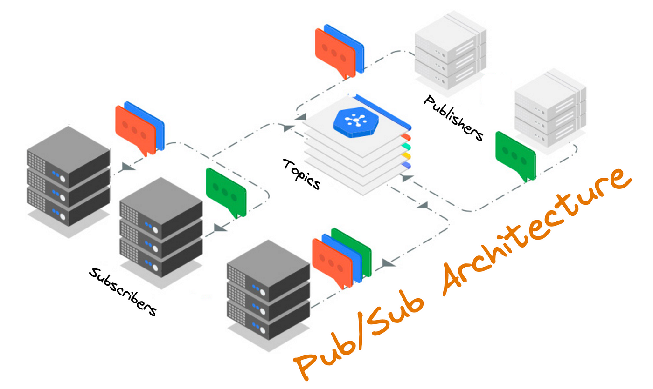
The Advantages of A Pub/Sub Architecture
Scalability: Handles growing numbers of users and messages with ease. Flexibility: Adapts to changing needs and allows for expansion into other areas (housing, food assistance) simply by creating new topics.
Efficiency: Eliminates unnecessary communication by ensuring posts only reach interested parties.

Slide 9

RabbitMQ: The Engine Behind the App
Why RabbitMQ?
Free and opensource, with a proven track record, used by millions globally.
Works in the cloud, on your servers, or even your laptop.
Customize how messages are routed and delivered to meet your exact needs.
Ensures messages are delivered and protected with acknowledgements and replication.

Slide 10
A User-Friendly home screen Experience
TODO: Mockup of the app's home screen
Simple Navigation: Clear tabs for browsing resources, managing subscriptions, and viewing notifications.
Personalized Feed: Displays relevant posts based on the user’s subscriptions and preferences.
Search Functionality: Allows students, providers, and admins to easily find specific resources or organizations.

Slide 11
Subscribing to Topics
Mockup of the app's subscription management screen
Topic Categories: Organized by ESL level, class type (conversation, work-specific, etc.), location, and schedule.
Easy Subscription: Students, providers, and admins simply select the topics that match their needs.
Notification Preferences: Users have control over how they receive updates (e.g., instant notifications, daily digest), as well as modality (app-only, email, SMS, WhatsApp)

Slide 12
Publishing Resources
Mockup of the app's resource publishing screen
Structured Templates: Pre-defined fields for class details, schedules, contact information, and more.
Targeted Publishing: Choose which topics to publish to, ensuring information reaches the right students or interested partner providers.
Real-time Updates: Easily edit posts to keep information current.

Slide 13
Managing the Platform
Mockup of the app's admin dashboard
User Management: Create accounts for providers and manage student access.
Topic Organization: Create, modify, and categorize topics to ensure efficient information flow.
Data Analytics: Track platform usage, identify trends, and measure program impact.

Slide 14

Thank you
Ryan Moore: moore.wil@northeastern.edu
Cody Snow: snow.cod@northeastern.edu
Sam Treadwell: treadwell.sa@northeastern.edu

